Slide 1
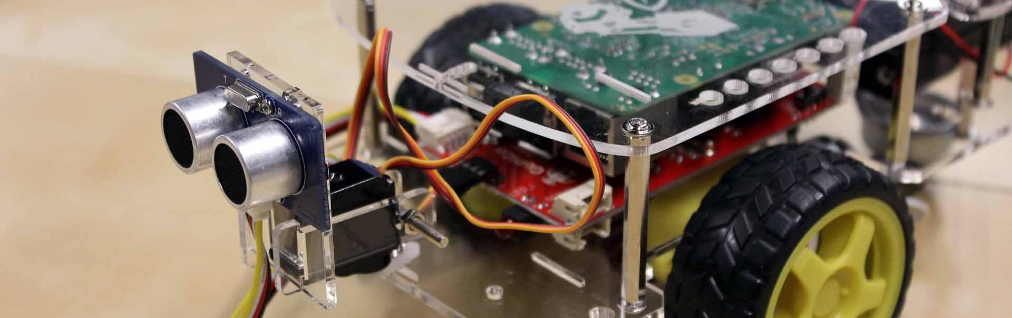
GoPiGo Box Locator
Group members: Eric Clifford, Ernest martin, Phillip pappan, Ray thibodeaux

Slide 2
development
Developed entirely using Python 3
Used primarily the EasyGoPiGo library to:
Maneuver the robot
Rotate the servo (the device the ultrasonic sensor is attached to)
Collect distance data using the ultrasonic sensor
Also made use of the trig functions within the math library in order to calculate distances

Slide 3
Finding boxes
The car moves forward while simultaneously scanning for forward and rightward distances
Those rightward distances will be used to calculate the object’s distance from the car’s path
When an object’s distance is close enough to be considered a box the car will position itself in front of that box and a led will flash

Slide 4
end of 2nd pass?
Start
Yes
End
Box detected?
No
Yes
No
Scan forward
Yes
At a wall?
Moving towards a box?
Turn around
Yes
No
Move forward
No
Scan rightward

Slide 5
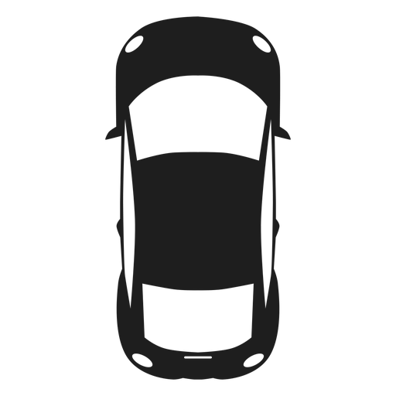
Calculating distance
We can use the diagonal distances obtained from the right of the car to calculate the distance the object is from the car’s path using simple trigonometry.
Formula to obtain B = C * Sin(θ)
Info we need:
B = object’s distance from the car’s path
Info we have:
θ = the angle that we positioned the servo
C = the diagonal distance we obtained from scanning right
B
A
C
θ

Slide 6
Problems
Problem: It is impossible to differentiate a box from any other object with the current hardware allocated to us
Temporary solution: The car considers any object to its right that is adequately close to be a box (the car is set to consider objects up to 5 feet from it a box but this can be adjusted). By keeping objects that aren’t boxes out of this area you can prevent them from being detected as a box.
Long-term solution: This issue can be better resolved in the future by placing a camera on the car allowing us to detect if each object in our range of detection is indeed a box.

